Slide 1
whois
Kyma Maintainer
Kubernetes Member
Service Catalog SIG Chair
Mateusz Szostok
Software Engineer
at SAP Labs Poland

Slide 2
Migrate the Aggregated API Server to the CRD - is that even possible? Mateusz Szostok, SAP

Slide 3
You will learn
What technical implications of the two approaches are.
Why it's worth to move to CRDs in your project.
How to do a migration from the API server to the CRD approach.

Slide 4
Kyma project
Modernize your applications​ in a cloud-native fashion​.
Kyma is an open-source project
designed natively on Kubernetes.

Slide 5
Kyma Features
Serverless
Service Management
Application Connector

Slide 6
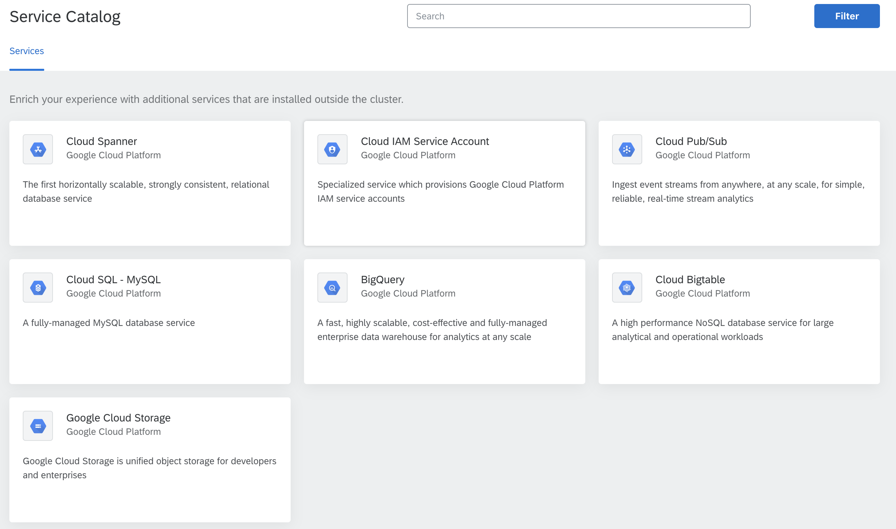
Service Catalog
Open Service Broker API

Slide 7
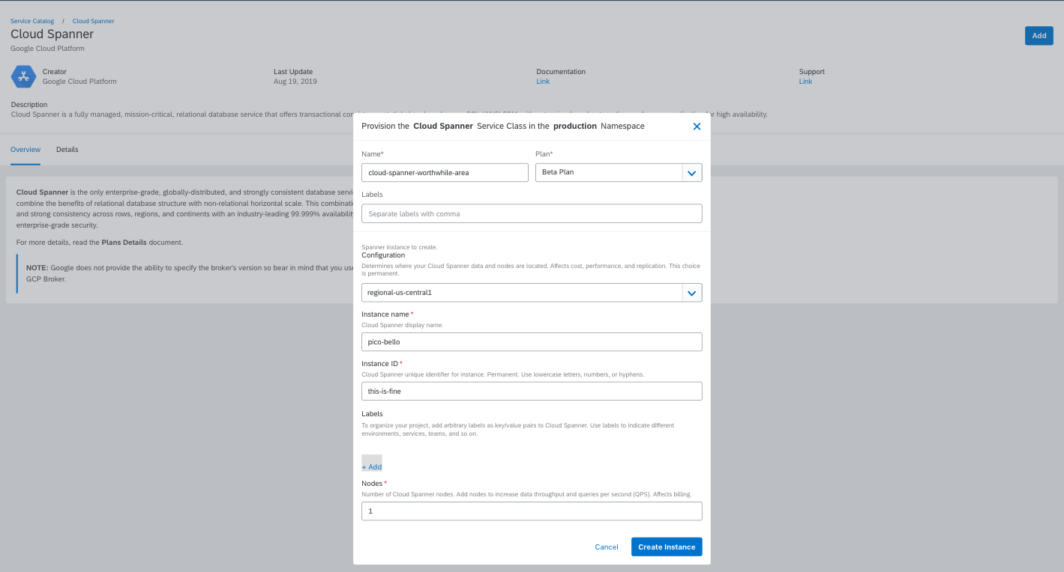
Service Catalog
Open Service Broker API

Slide 8
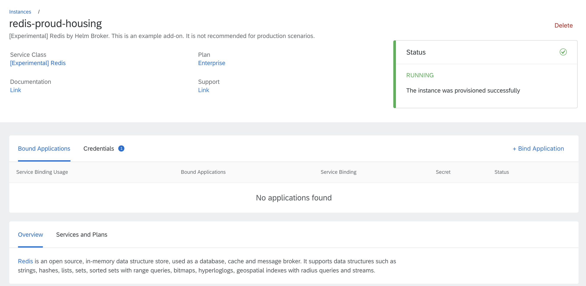
Service Catalog
Open Service Broker API

Slide 9
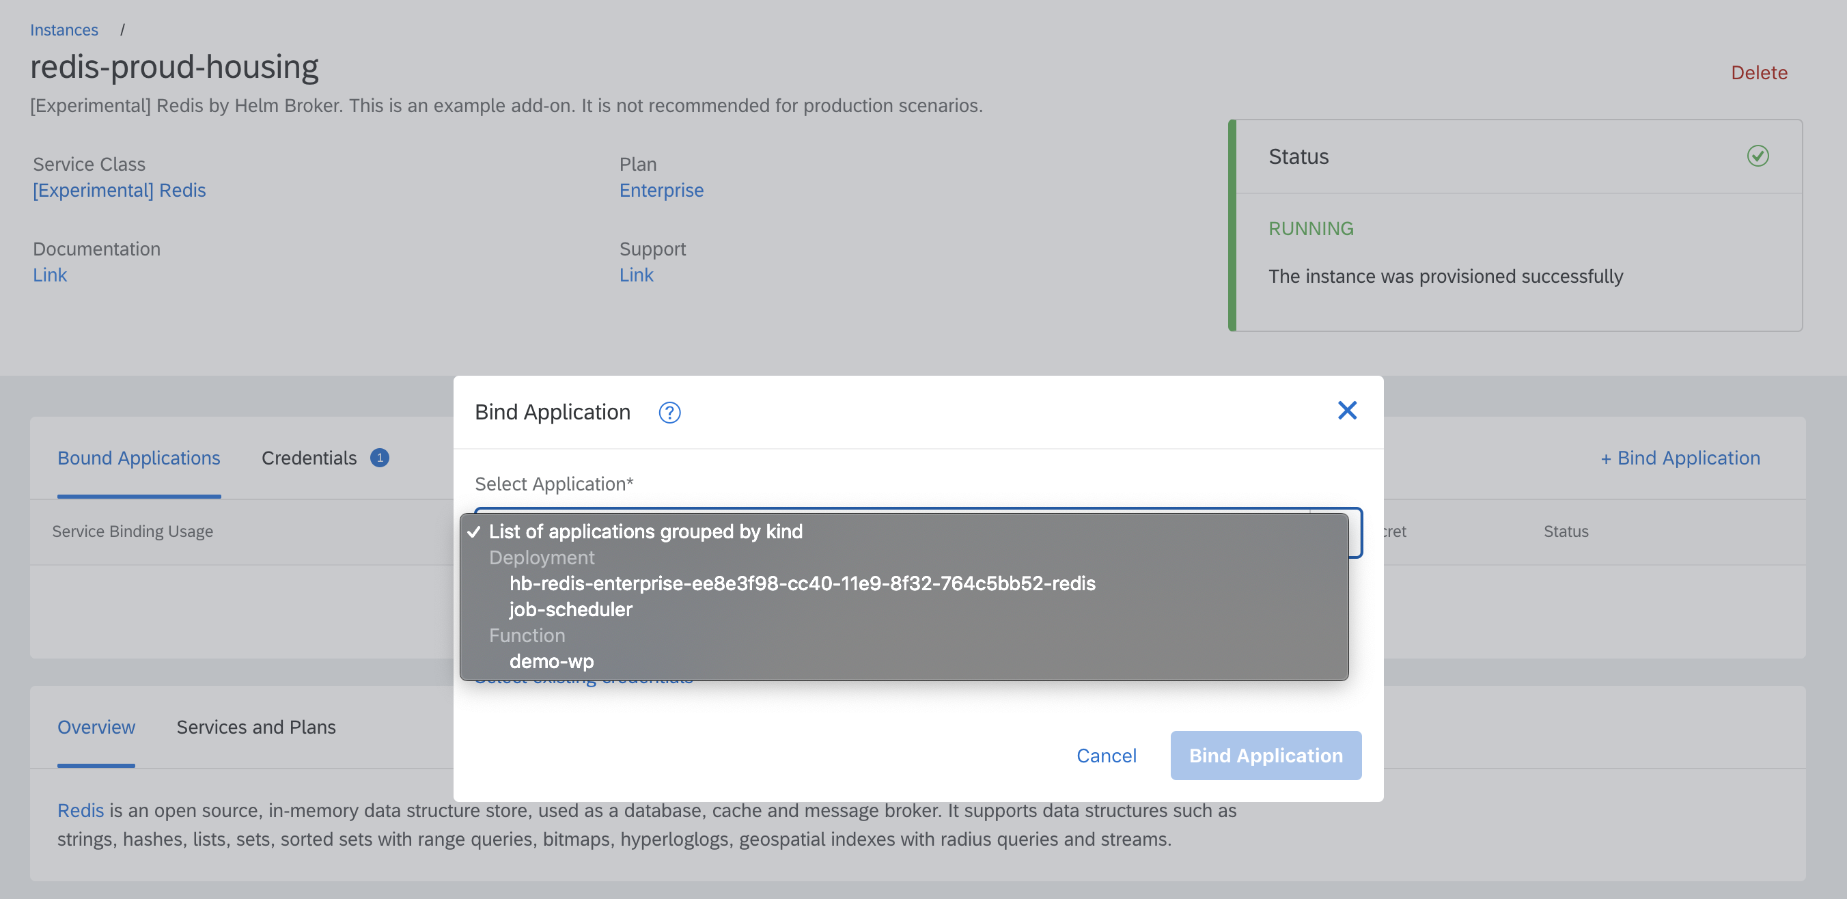
Service Catalog
Open Service Broker API

Slide 10
Service Catalog
Open Service Broker API
apiVersion: servicecatalog.k8s.io/v1beta1
kind: ClusterServiceClass
apiVersion: servicecatalog.k8s.io/v1beta1
kind: ClusterServicePlan
apiVersion: servicecatalog.k8s.io/v1beta1
kind: ServiceClass
apiVersion: servicecatalog.k8s.io/v1beta1
kind: ServicePlan
apiVersion: servicecatalog.k8s.io/v1beta1
kind: ServiceInstance
apiVersion: servicecatalog.k8s.io/v1beta1
kind: ServiceBinding

Slide 11
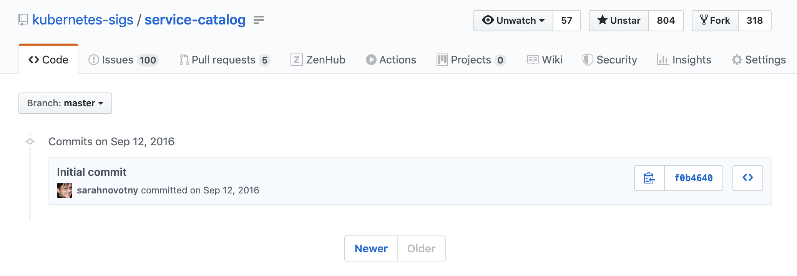
Long long time ago

Slide 12
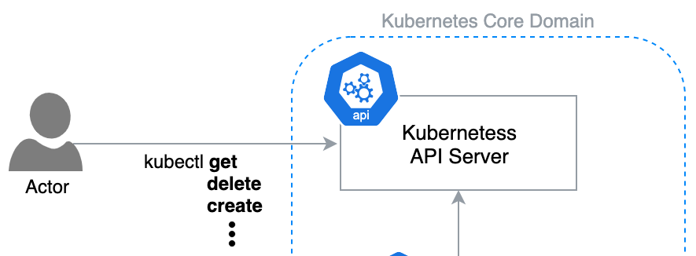
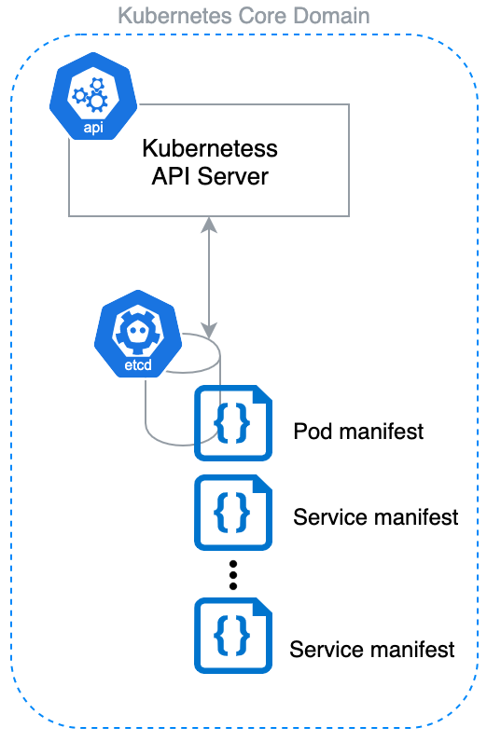
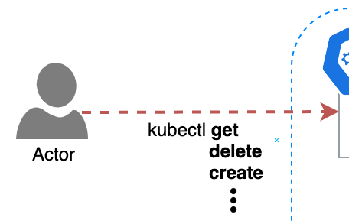
API Server Architecture

Slide 13
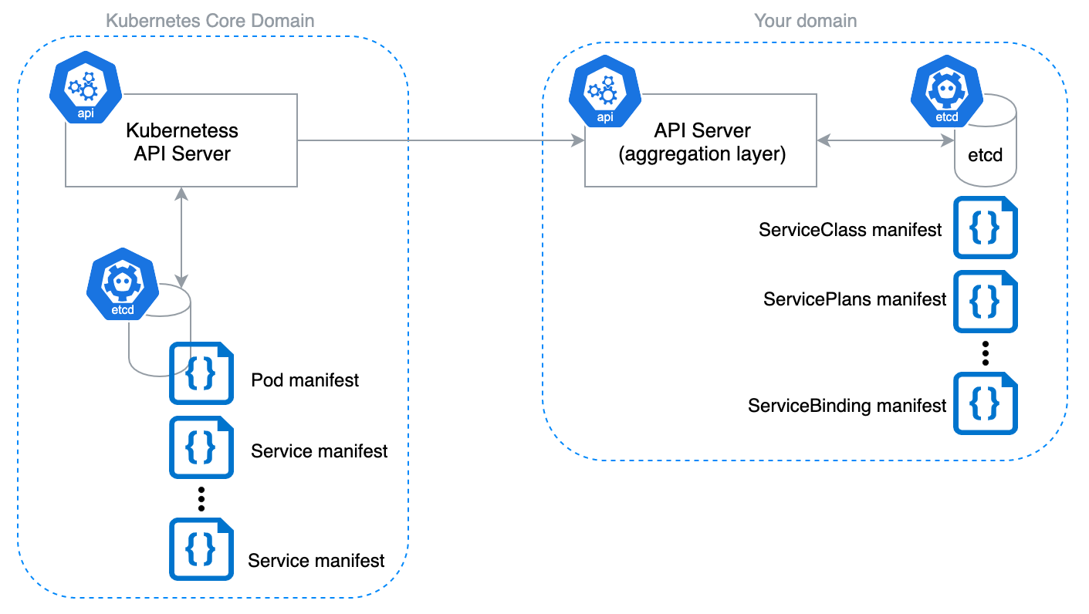
API Server Architecture

Slide 14
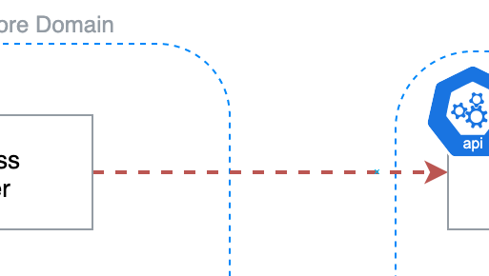
API Server Architecture

Slide 15
?
How good architecture goes bad
a.k.a why it's worth switching to CRDs in your project

Slide 16
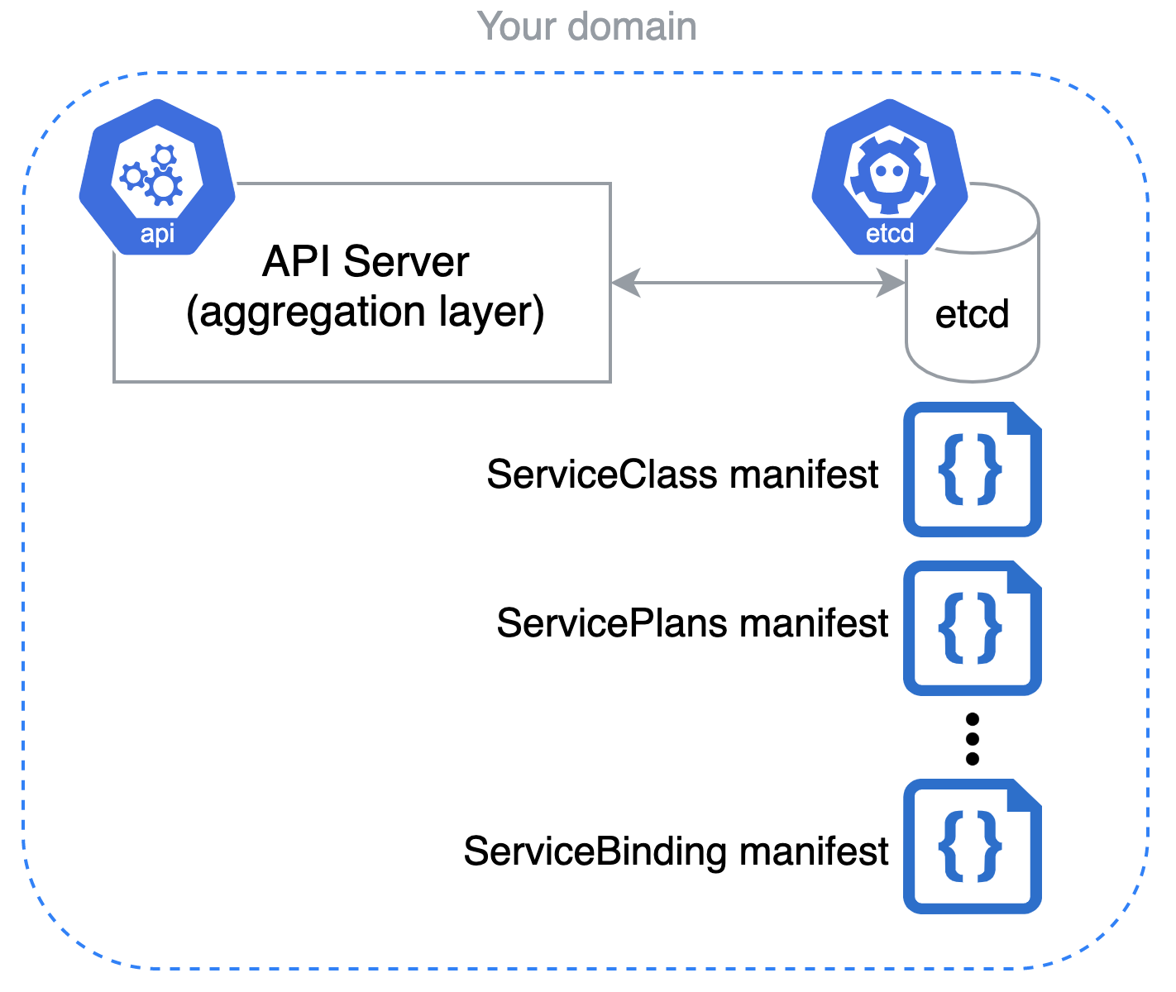
reason 0

Slide 17
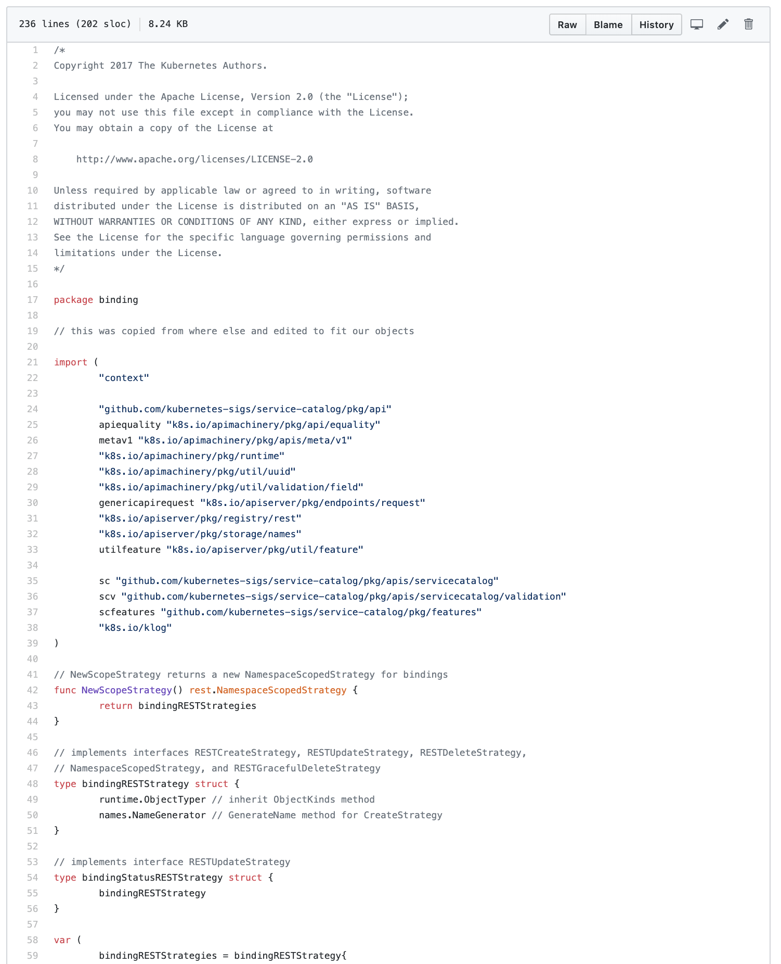
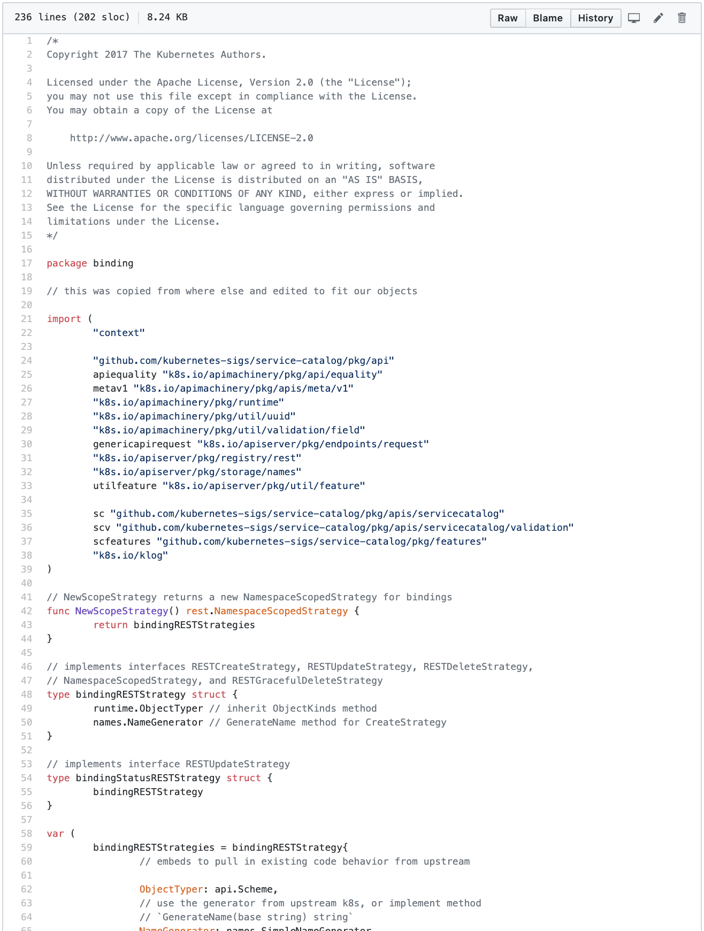
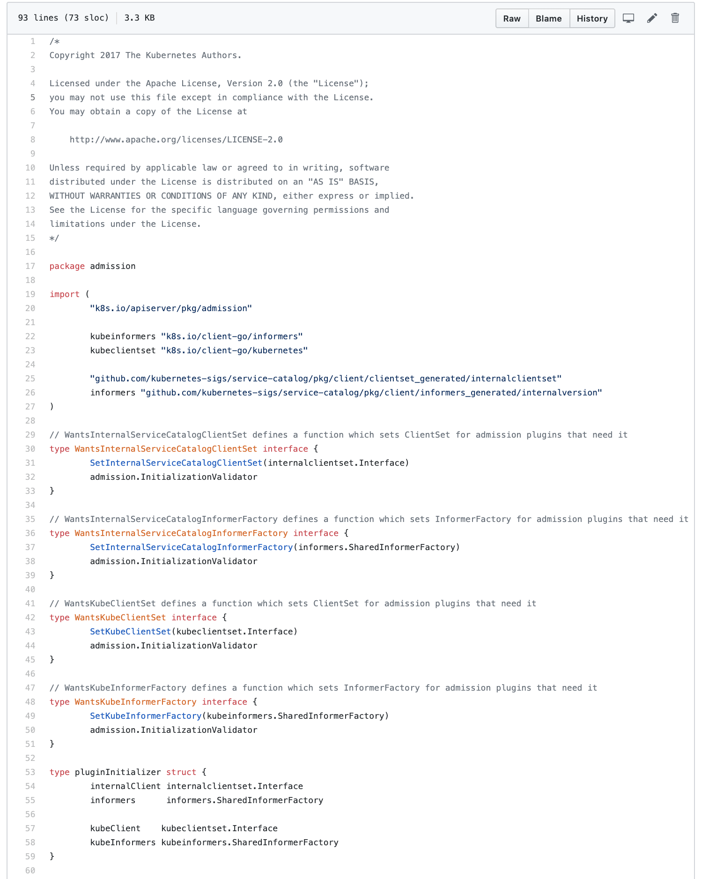
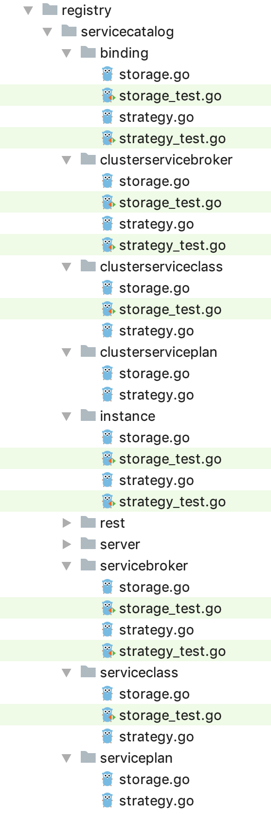
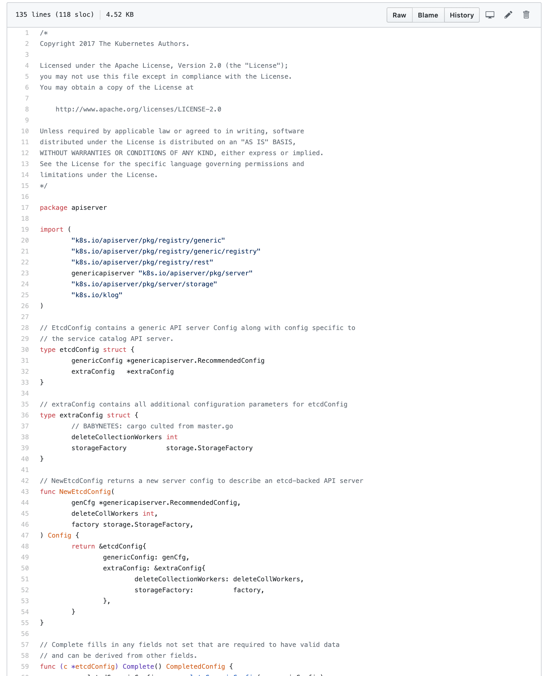
reason 0

Slide 18
reason 0
Owning a lot of code
Problem: without regular love, code grows with localized fixes and additions, which are globally crappy

Slide 19
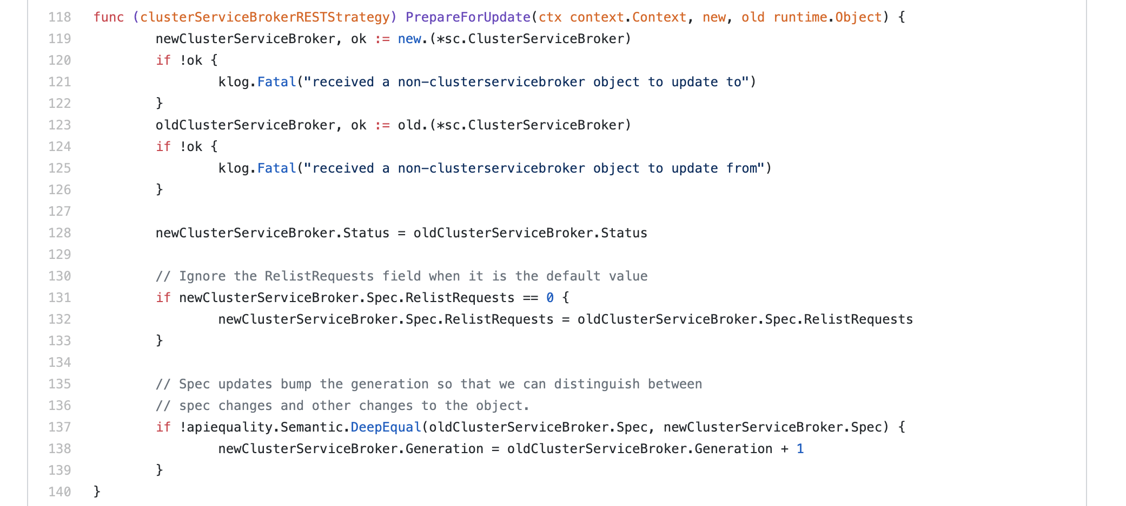
reason 1

Slide 20
reason 1
Duplicating core logic
Problem: Easy to introduce bugs
Problem: Hard to follow best practices

Slide 21
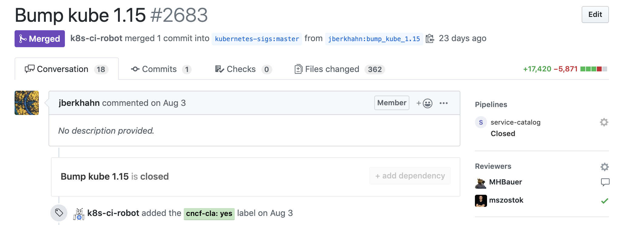
reason 2

Slide 22
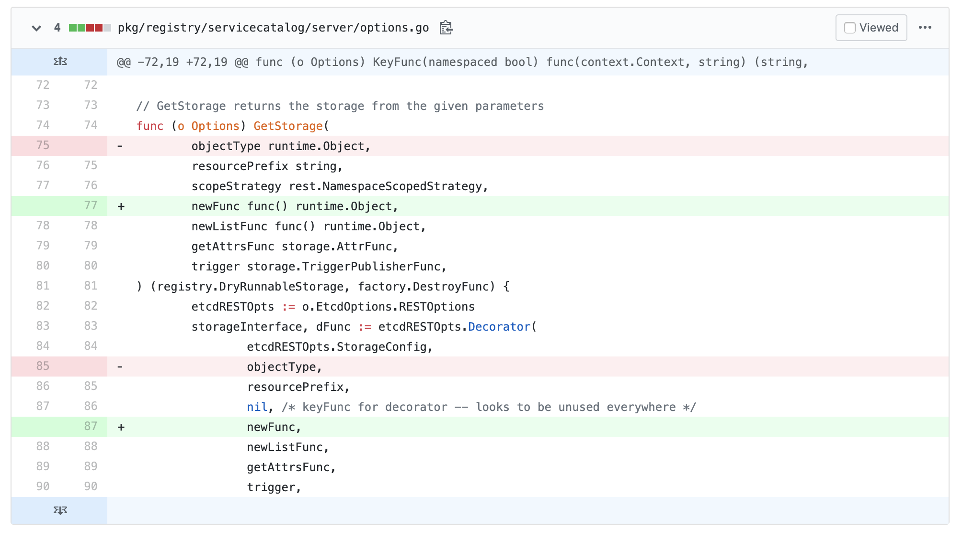
reason 2

Slide 23
reason 2
Be in sync with Kubernetes version
Problem: a lot of manual changes

Slide 24
reason 3
The open-source project is a living organism developed by people who come & go
… or just go.

Slide 25
reason 3
New contributors slowly violate unwritten rules.

Slide 26
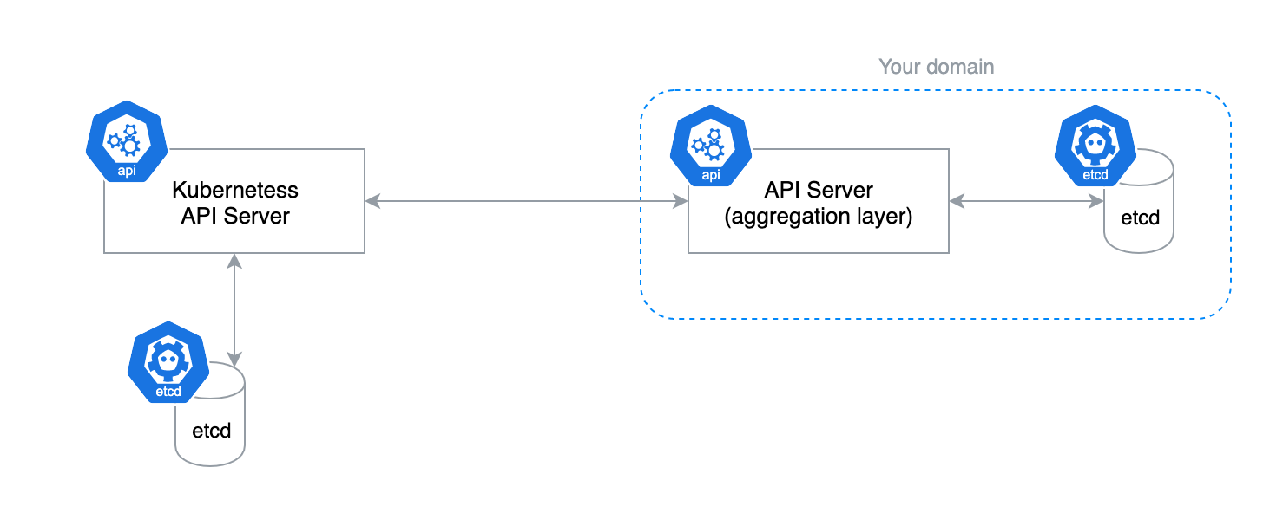
reason 4

Slide 27
reason 4
Requires own etcd storage
Problem: your clients need to maintain an additional database.

Slide 28
New kid on the block

Slide 29
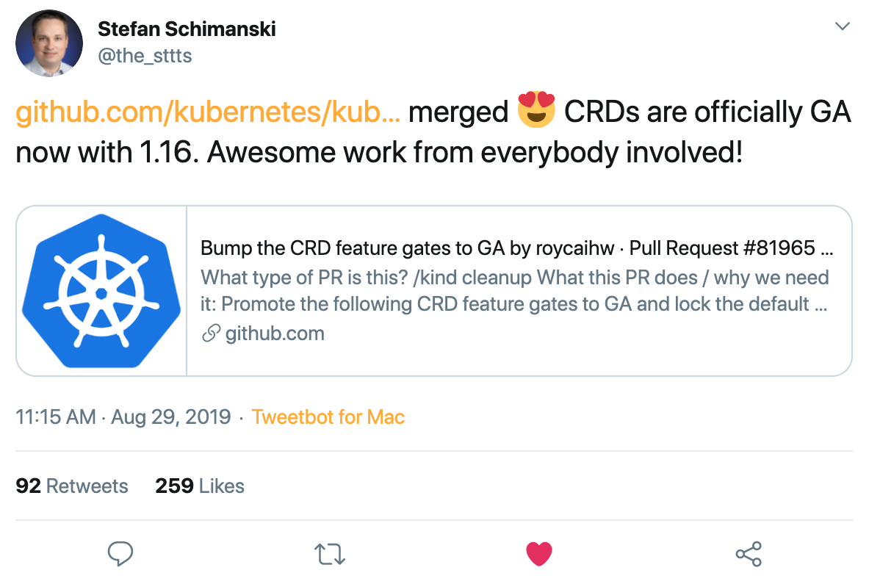
New kid on the block

Slide 30
How hard CRUD could be?

Slide 31
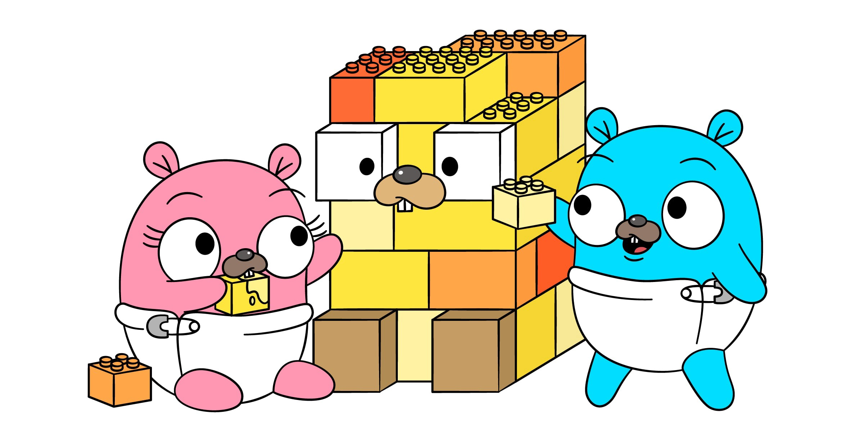
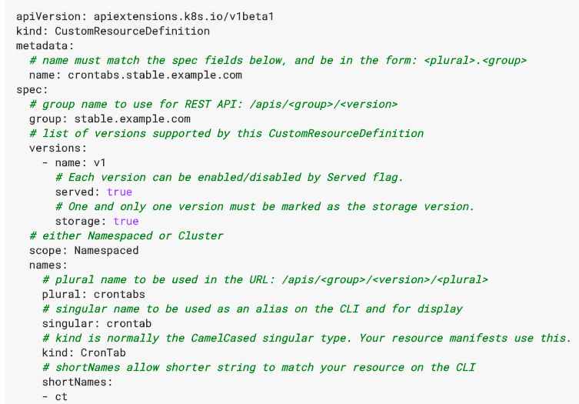
How hard CRUD could be?

Slide 32
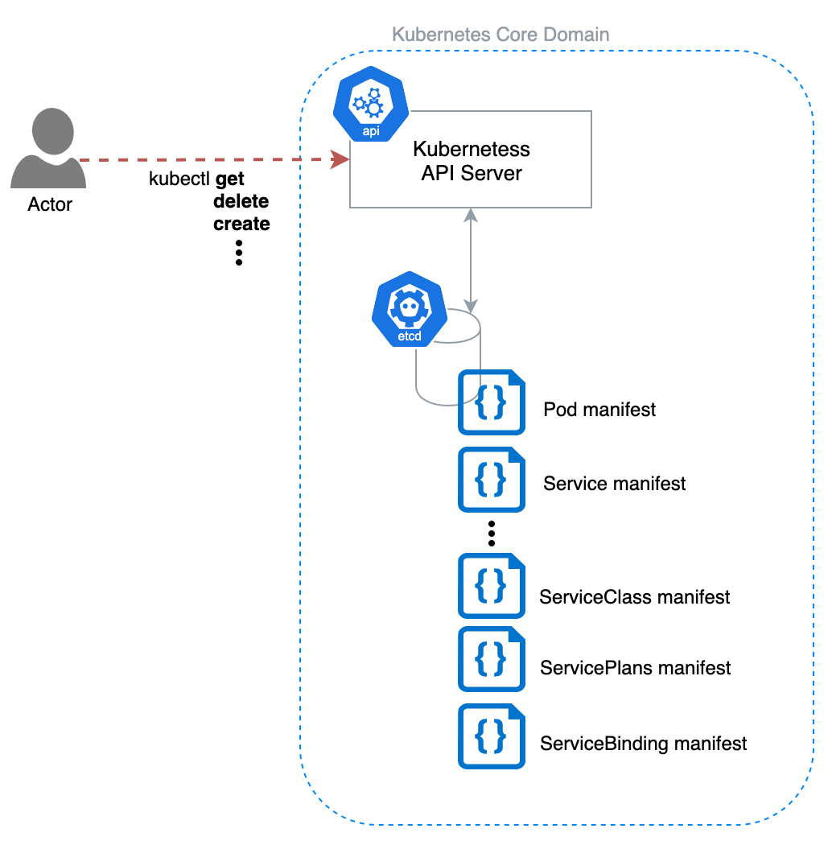
How hard CRUD could be?

Slide 33
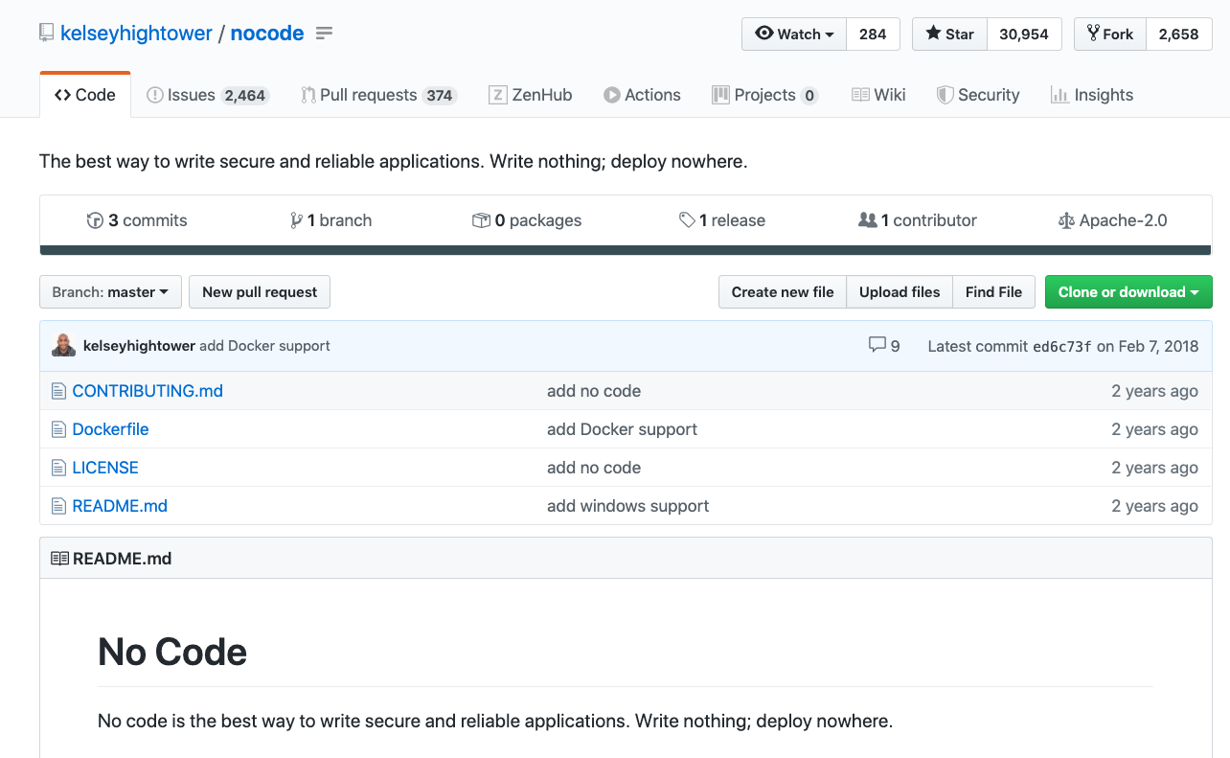
How hard CRUD could be?

Slide 34
?
Are we missing something

Slide 35
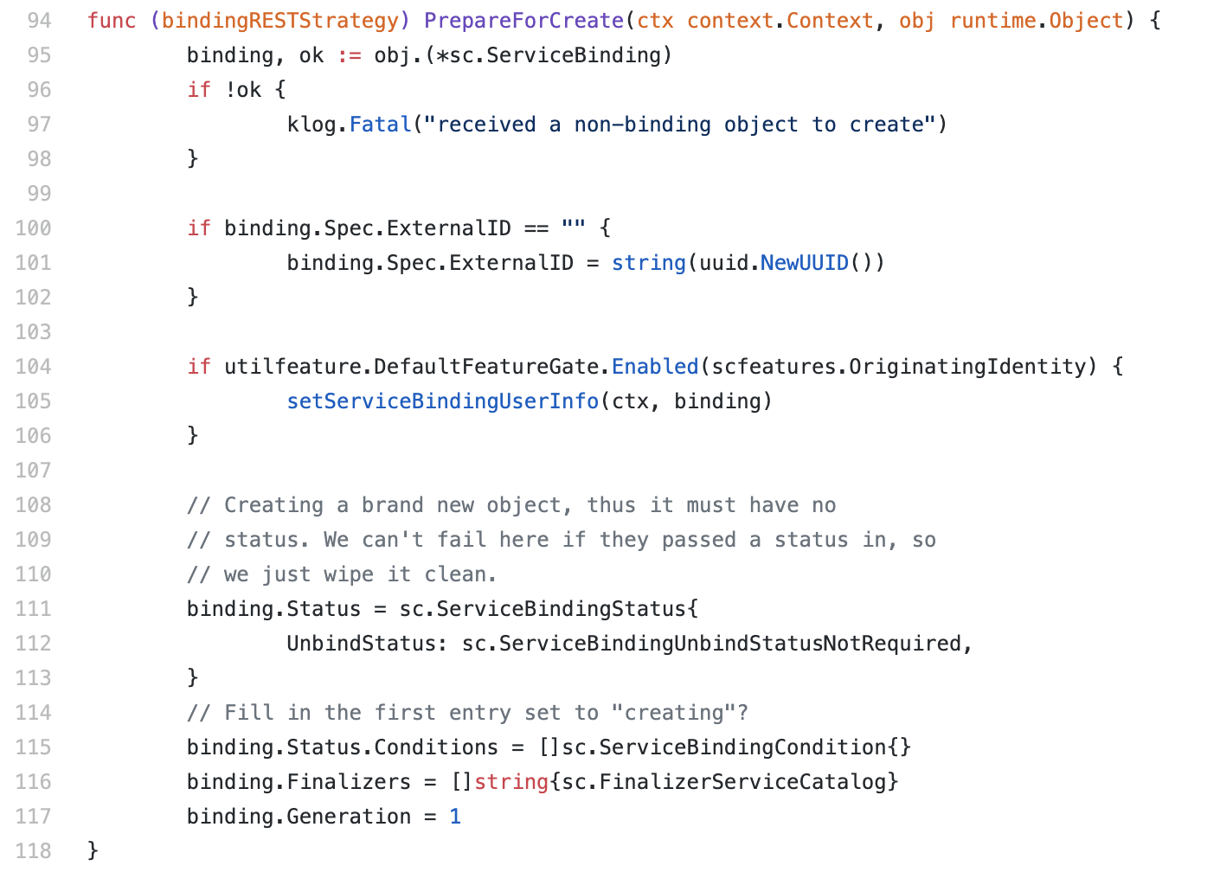
Business logic

Slide 36
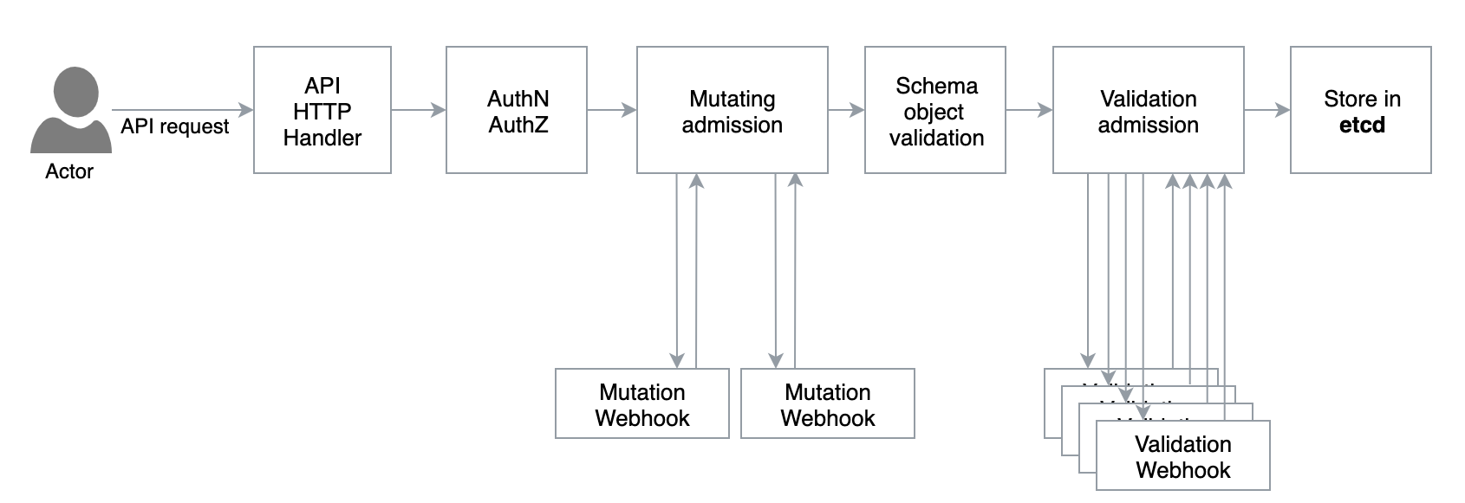
CRDs approach

Slide 37
Make room for Admission Webhooks

Slide 38
Make room for Admission Webhooks

Slide 39
Make room for Admission Webhooks
apiVersion: admissionregistration.k8s.io/v1beta1
kind: MutatingWebhookConfiguration
metadata:
name: example
webhooks:
- name: mutating.pod.k8s.io
rules:
- operations: [ "CREATE", "UPDATE" ]
apiGroups: [""]
apiVersions: ["v1"]
resources: ["pods"]
clientConfig:
service:
name: webhook-svc
path: "/mutate"

Slide 40
Make room for Admission Webhooks

Slide 41
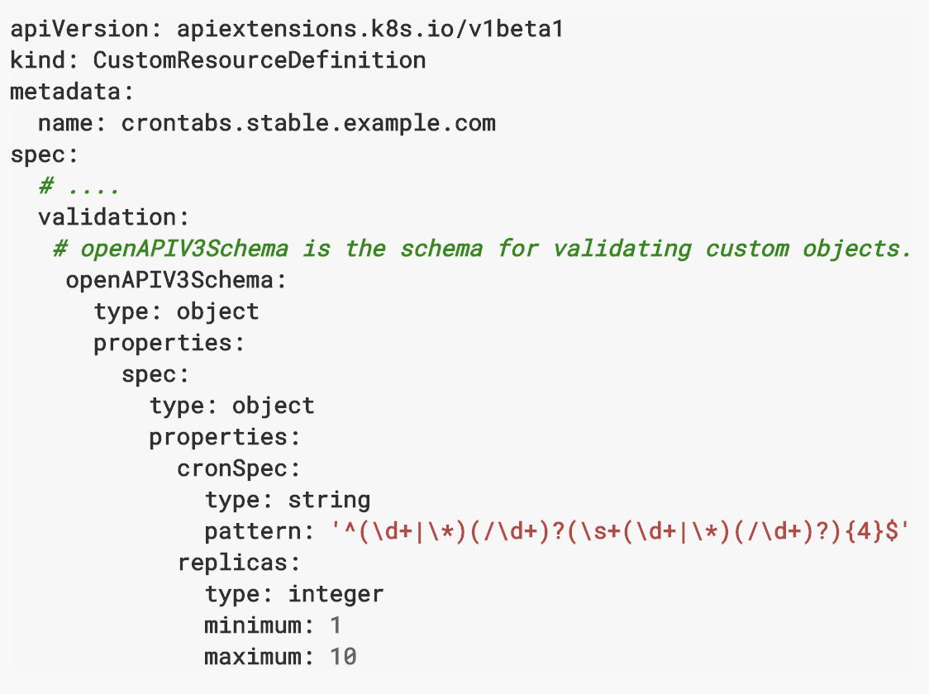
Make room for Admission Webhooks

Slide 42
Make room for Admission Webhooks

Slide 43
Make room for Admission Webhooks

Slide 44
Make room for Admission Webhooks
apiVersion: admissionregistration.k8s.io/v1beta1
kind: ValidatingWebhookConfiguration
metadata:
name: example
webhooks:
- name: validating.pod.k8s.io
rules:
- operations: [ "CREATE", "UPDATE" ]
apiGroups: [""]
apiVersions: ["v1"]
resources: ["pods"]
clientConfig:
service:
name: webhook-svc
path: "/validate"

Slide 45
?
How to move your features

Slide 46
Migrate your features
Subresource
A custom sub-resource allows you to define fine-grained actions on its Kind.
For example, user writes spec section, controller writes status section.
TableConvertor
API Server uses TableConvertor
for printing custom columns
on kubectl get command.
PrepareForCreate/Update func
Functions to adjust newly created resources or updates existing ones.
Validation
API Server uses plugins which are gathered
and registered as validators.
FieldSelector
Restricts the list of
returned objects by their fields.

Slide 47
Sub-resources
apiVersion: v1
kind: Pod
metadata:
name: helm-broker
spec:
containers:
- name: helm-broker
image: eu.gcr.io/kyma-project/helm-broker:release-0.1.5
status:
phase: Running
podIP: 172.17.0.6
startTime: "2019-09-06T10:38:26Z"
Resource
Sub-resource

Slide 48
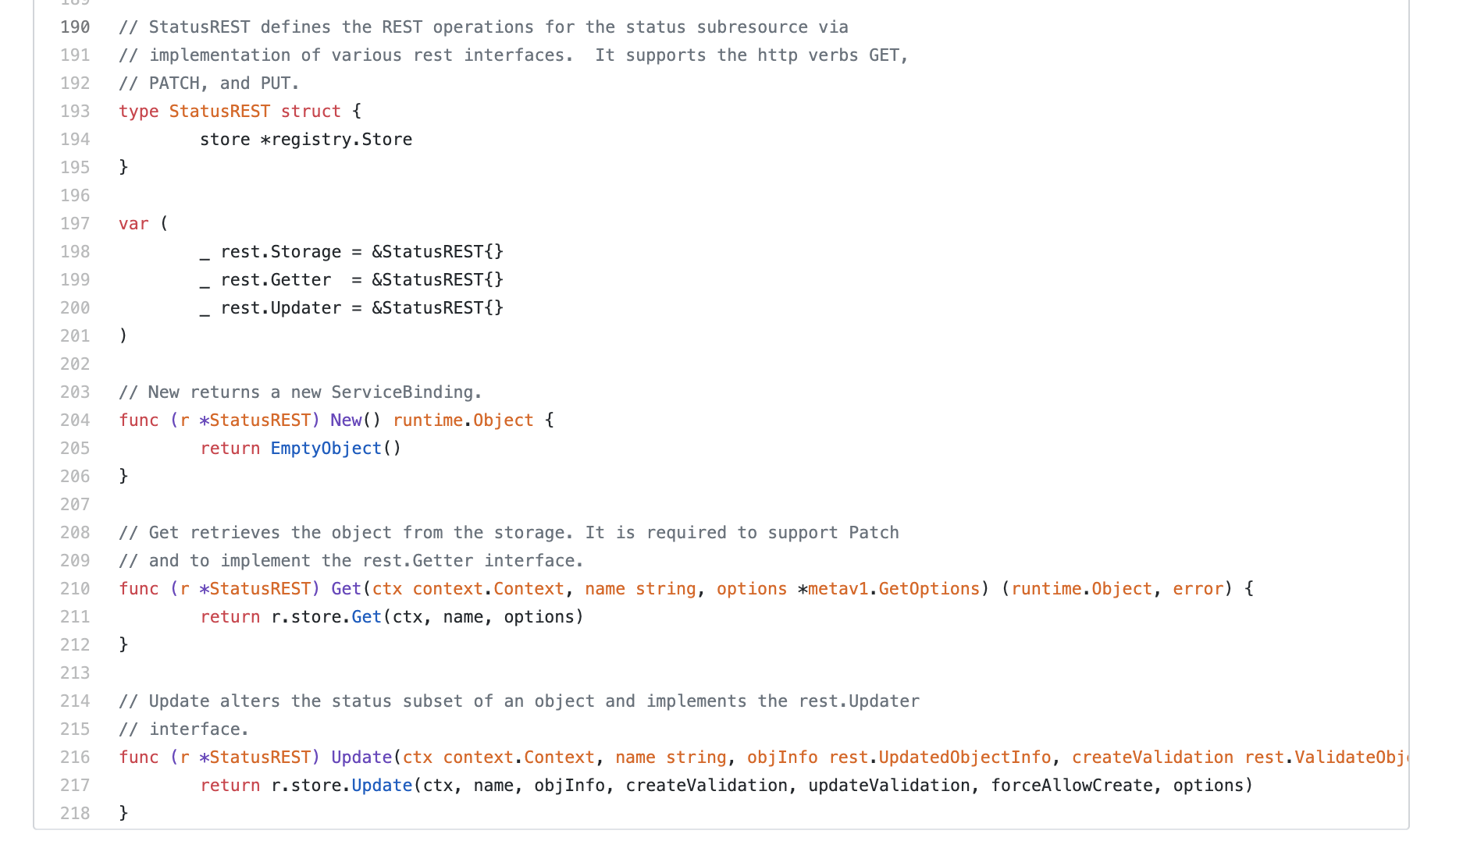
Sub-resource

Slide 49
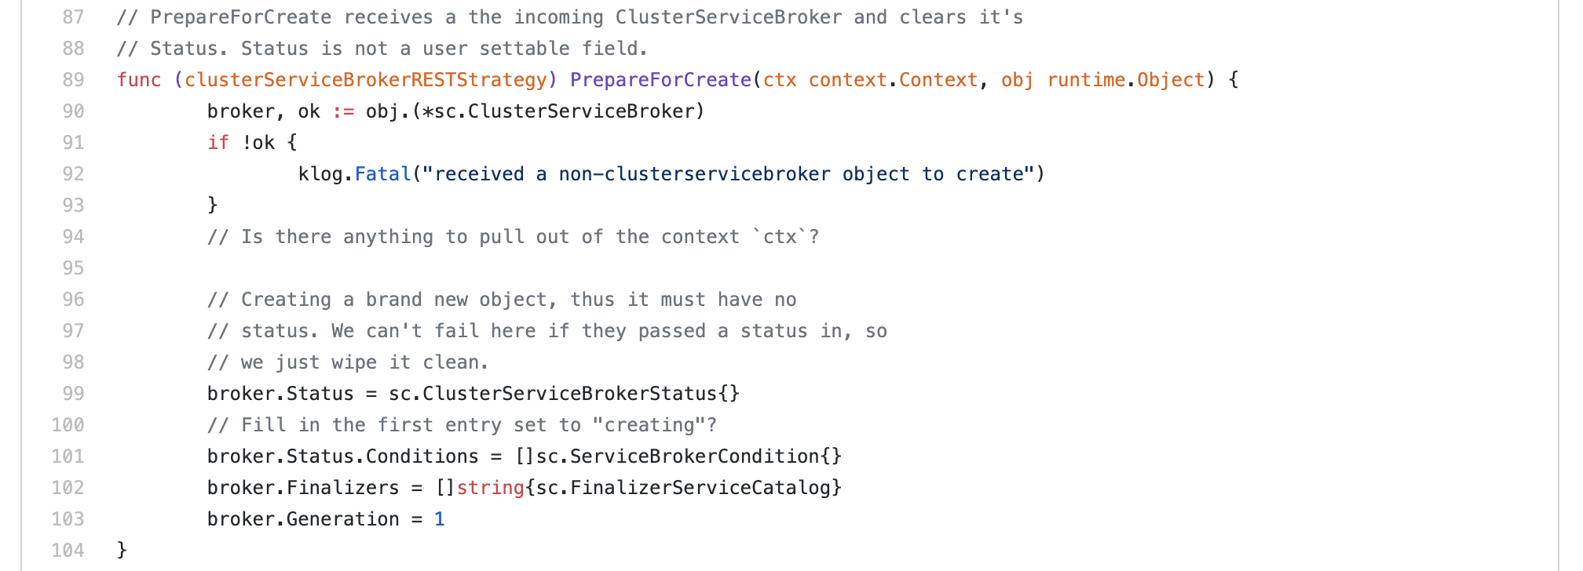
Sub-resources

Slide 50
Sub-resource
apiVersion: apiextensions.k8s.io/v1beta1 kind: CustomResourceDefinition metadata: name: clusterservicebrokers.servicecatalog.k8s.io spec: group: servicecatalog.k8s.io version: v1beta1 scope: Cluster names: plural: clusterservicebrokers singular: clusterservicebroker kind: ClusterServiceBroker
subresources: status: {}

Slide 51
Limitations
CRD supports only Scale and Status subresources definitions.
Other, such as logs or exec, are not supported.

Slide 52
Migrate your features
Subresource
A custom sub-resource allows you to define fine-grained actions on its Kind.
For example, user writes spec section, controller writes status section.
TableConvertor
API Server uses TableConvertor
for printing custom columns
on kubectl get command.
PrepareForCreate/Update func
Functions to adjust newly created resources or updates existing ones.
Validation
API Server uses plugins which are gathered
and registered as validators.
FieldSelector
Restricts the list of
returned objects by their fields.

Slide 53
Table Convertor
$ kubectl get servicebinding --all-namespaces
NAMESPACE NAME SERVICE-INSTANCE SECRET-NAME STATUS AGE
default frosty-haibt demo-currency-converter frosty-haibt Ready 28d
default reverent-ritchie wordpress reverent-ritchie Ready 28d
demo blissful-curran demo-currency-converter-quarterly-show blissful-curran Ready 15d
demo boring-liskov demo-currency-converter-quarterly-show boring-liskov Ready 15d
demo elastic-nightingale wordpress-103ba-wee-other elastic-nightingale Ready 15d
demo relaxed-darwin redis-proud-housing relaxed-darwin Ready 4d23h
Kubernetes Defaults
Customization

Slide 54
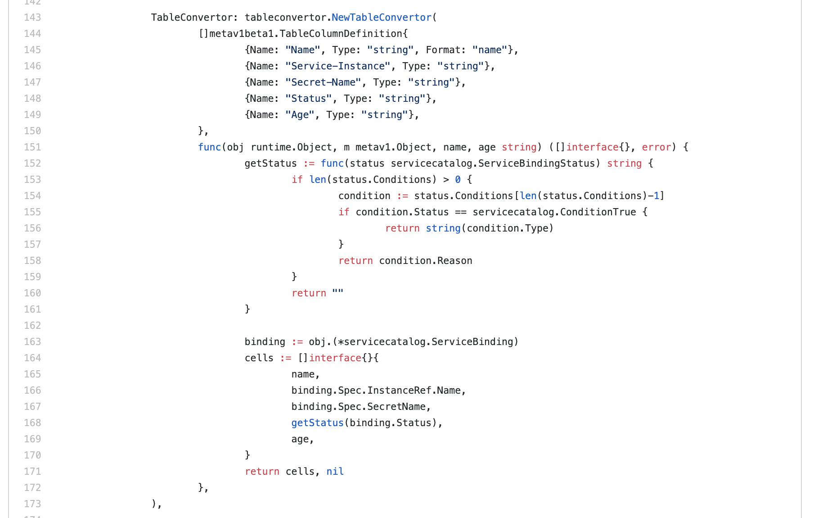
Table Convertor

Slide 55
Additional printer columns
apiVersion: apiextensions.k8s.io/v1beta1 kind: CustomResourceDefinition metadata: name: servicebindings.servicecatalog.k8s.io spec:
... additionalPrinterColumns: - name: Service-Instance type: string JSONPath: .spec.instanceRef.name - name: Secret-Name type: string JSONPath: .spec.secretName - name: Status type: string JSONPath: .status.lastConditionState - name: Age type: date JSONPath: .metadata.creationTimestamp
Customization
Kubernetes Defaults

Slide 56
Migrate your features
Subresource
A custom sub-resource allows you to define fine-grained actions on its Kind.
For example, user writes spec section, controller writes status section.
TableConvertor
API Server uses TableConvertor
for printing custom columns
on kubectl get command.
PrepareForCreate/Update func
Functions to adjust newly created resources or updates existing ones.
Validation
API Server uses plugins which are gathered
and registered as validators.
FieldSelector
Restricts the list of
returned objects by their fields.

Slide 57
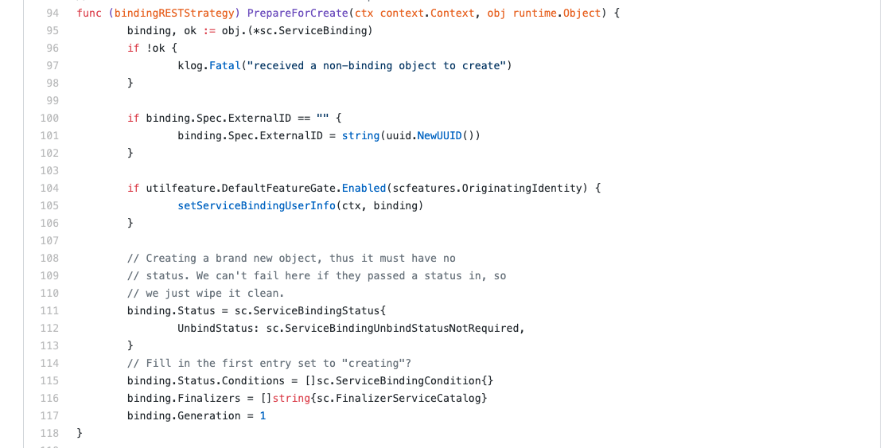
API Server – Prepare for create

Slide 58
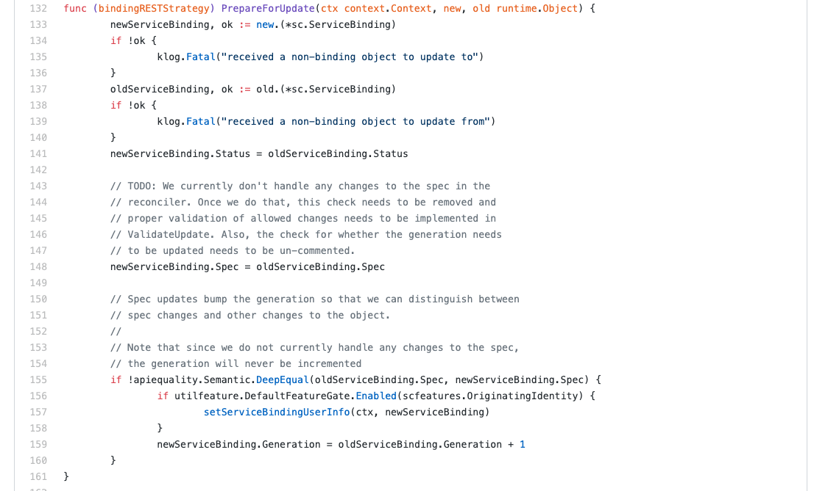
API Server – Prepare for update

Slide 59
How to convert that into mutation webhook
apiVersion: admissionregistration.k8s.io/v1beta1
kind: MutatingWebhookConfiguration
metadata:
name: example
webhooks:
- name: mutating.svcat.k8s.io
rules:
- operations: [ "CREATE", "UPDATE" ]
apiGroups: [”svcat.k8s.io"]
apiVersions: [”v1beta1"]
resources: [”serviceinstances"]
clientConfig:
service:
name: webhook-svc
path: "/mutate"

Slide 60
How to implement that
Controller Runtime & Controller Tools
Kubebuilder
Operator SDK
Metacontroller

Slide 61
Metacontroller in your cluster

Slide 62
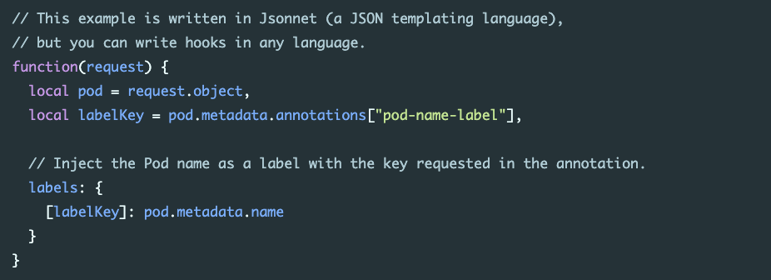
Metacontroller

Slide 63
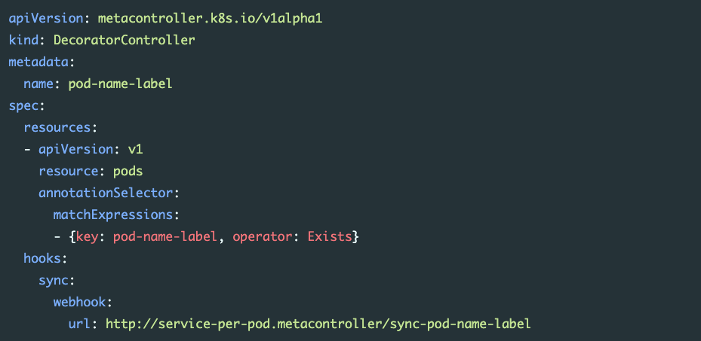
Metacontroller

Slide 64
Metacontroller
Pros
Simplified way of writing mutation handlers
No direct Kubernetes dependency in your handler code
Cons
Dependency on metacontroller Kubernetes support live-cycle
Need for installation of metacontroller on your cluster

Slide 65
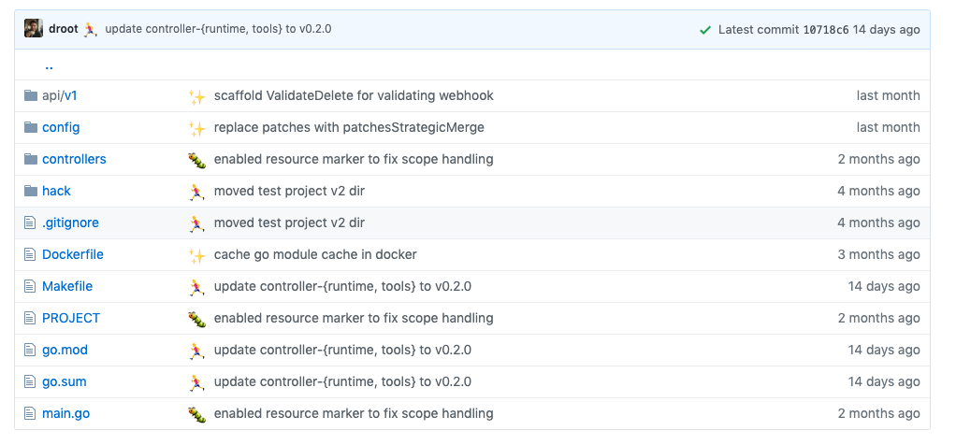
Kubebuilder & Operator SDK
$ kubebuilder init --domain my.domain
$ kubebuilder create api --group webapp --version v1 --kind Guestbook

Slide 66
Kubebuilder & Operator SDK
Simplify the process of building a Kubernetes webhook server (or controller). Both projects make extensive use of the upstream controller-runtime and controller-tools projects, and therefore scaffold similar Go source files and package structures.
Kubebuilder has a significant breaking changes between v1 to v2 versions.
Downstreaming Kubebuilder in the near future.

Slide 67
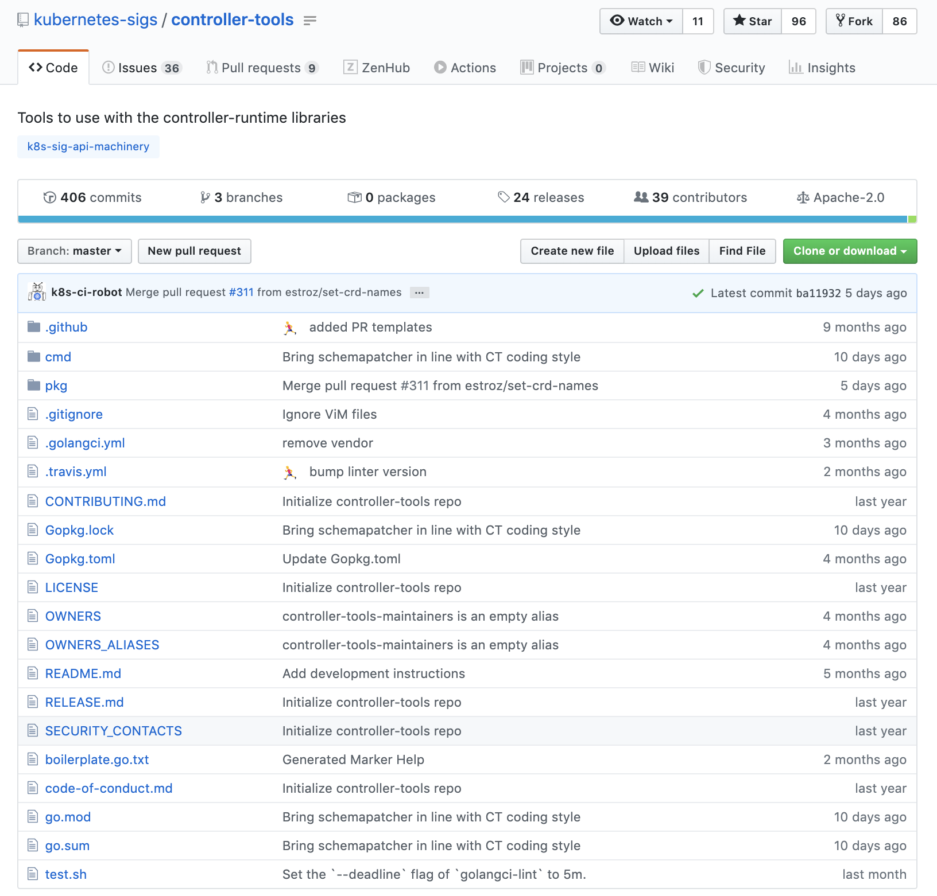
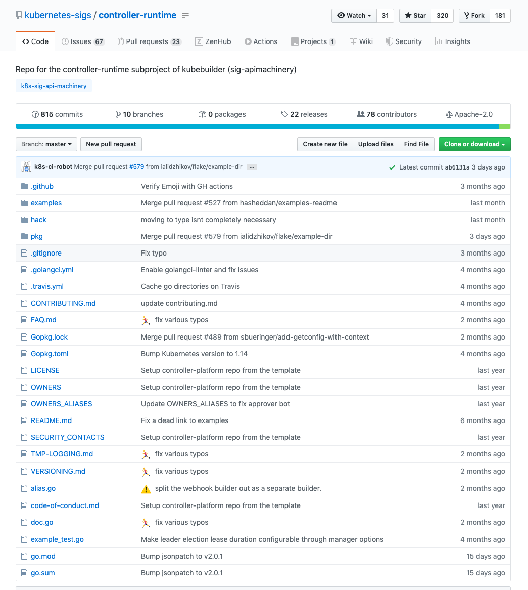
Controller-runtime & Controller-tools

Slide 68
Controller-runtime & Controller-tools

Slide 69
Webhook Server

Slide 70
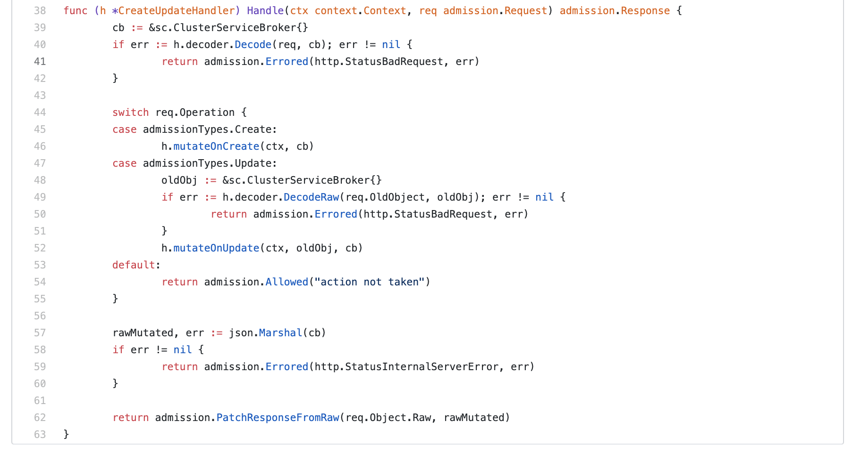
Mutation handler

Slide 71
Business logic

Slide 72
Mutation handler

Slide 73
Migrate your features
Subresource
A custom sub-resource allows you to define fine-grained actions on its Kind.
For example, user writes spec section, controller writes status section.
TableConvertor
API Server uses TableConvertor
for printing custom columns
on kubectl get command.
PrepareForCreate/Update func
Functions to adjust newly created resources or updates existing ones.
Validation
API Server uses plugins which are gathered
and registered as validators.
FieldSelector
Restricts the list of
returned objects by their fields.

Slide 74
Business logic

Slide 75
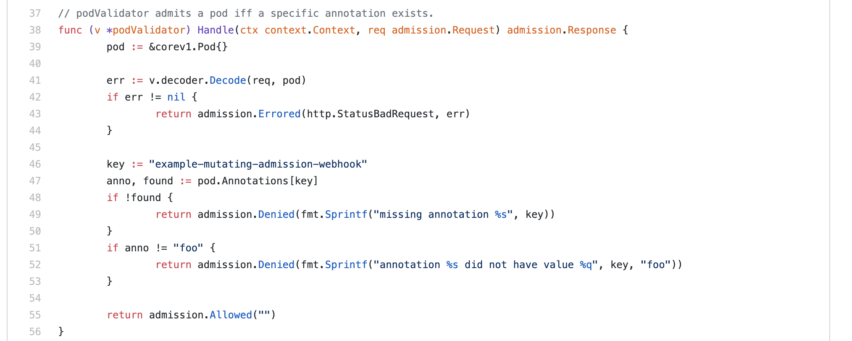
Business logic

Slide 76
Migrate your features
Subresource
A custom sub-resource allows you to define fine-grained actions on its Kind.
For example, user writes spec section, controller writes status section.
TableConvertor
API Server uses TableConvertor
for printing custom columns
on kubectl get command.
PrepareForCreate/Update func
Functions to adjust newly created resources or updates existing ones.
Validation
API Server uses plugins which are gathered
and registered as validators.
FieldSelector
Restricts the list of
returned objects by their fields.

Slide 77
FieldSelector

Slide 78
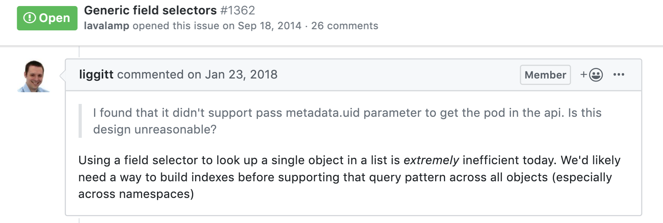
CRDs - Field Selector

Slide 79
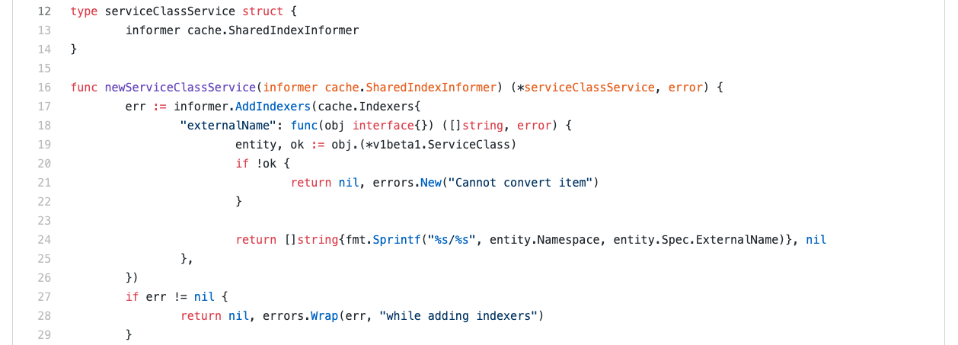
Option 1: Mom said to share!

Slide 80
Option 1: Mom said to share!

Slide 81
Option 1: Mom said to share!
SharedInformers & Indexer concepts are processed on client-side.

Slide 82
Option 1: Mom said to share!
Problem: We have 3 separate areas in code:
Controller
Webhook server
svcat CLI
Each one needs to keep its own definition of informers and indexers.
For svcat, we need to populate cache from scratch on every command execution.

Slide 83
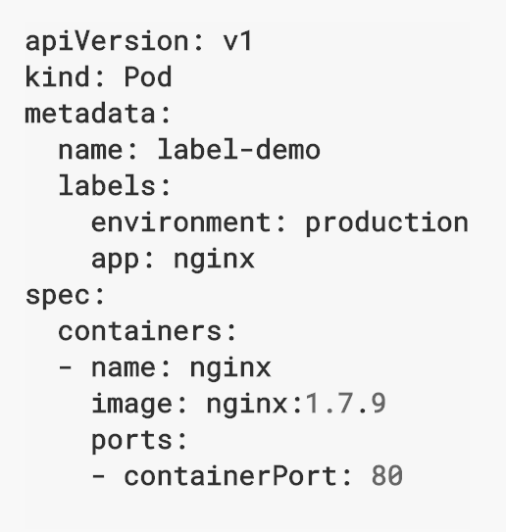
Option 2: Label me!

Slide 84
Option 2: Label me!

Slide 85
Option 2: Label me!
apiVersion: servicecatalog.k8s.io/v1beta1
kind: ClusterServiceClass
metadata:
name: sample-cluster-class
labels:
servicecatalog.k8s.io/spec.clusterServiceBrokerName: ups-broker
servicecatalog.k8s.io/spec.externalID: 4f6e6cf6-ffdd
servicecatalog.k8s.io/spec.externalName: user-provided-service
spec:
bindable: true
bindingRetrievable: false
clusterServiceBrokerName: ups-broker
description: A user provided service
externalID: 4f6e6cf6-ffdd
externalName: user-provided-service
planUpdatable: true

Slide 86
Option 2: Label me!

Slide 87
Option 2: Label me!

Slide 88
Option 2: Label me!

Slide 89
Migrate your features
Subresource
A custom sub-resource allows you to define fine-grained actions on its Kind.
For example, user writes spec section, controller writes status section.
TableConvertor
API Server uses TableConvertor
for printing custom columns
on kubectl get command.
PrepareForCreate/Update func
Functions to adjust newly created resources or updates existing ones.
Validation
API Server uses plugins which are gathered
and registered as validators.
FieldSelector
Restricts the list of
returned objects by their fields.

Slide 90
We did it! New architecture in place!
backward compatibility 95.99%

Slide 91
Remember: Ensure seamless upgrade for your clients
$ helm upgrade catalog ./chart/service-catalog

Slide 92
How to migrate your users
It’s the 92nd slide!

Slide 93
Things to take away
CRDs are awesome and production ready
Aggregate API Server is good if you need to customize core features
Upcoming blog posts with deep-dives... Stay tuned!
There are Kubernetes office hours meetings
…and you can always hit me up for more info ☺

Slide 94
Contact information
slack.kyma-project.io
slack.k8s.io
github.com/mszostok
Mateusz Szostok
Software Engineer
at SAP Labs Poland
twitter.com/m_szostok
linkedin.com/in/mszostok

Slide 95
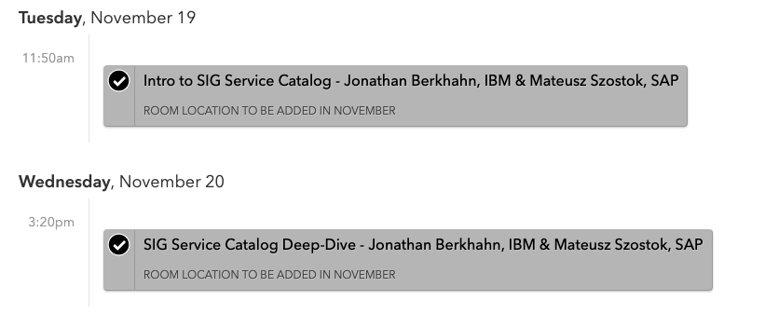
Contact information
Mateusz Szostok
Software Engineer
at SAP Labs Poland

Slide 96
Thank You

Slide 97
CRD Features
Add defaulting by using the default keyword
Enable pruning by setting spec.preserveUnknownFields: true
Evolve the CRD to a new version with a conversion webhook
kubectl explain works again, as OpenAPI schemas are now published
…and more

